Slide 2
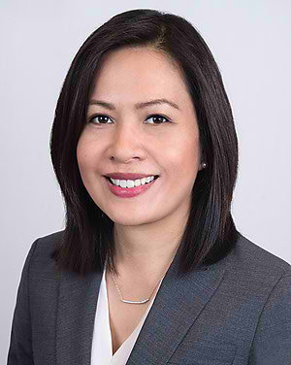
Lichen Planus
Zendee Elaba, MD
UMass Memorial Health

